Slide 1
Assessing and Managing Quality when customers and providers collaborate
Natàlia Amat-Lefort
Frederic Marimon
Marta Mas-Machuca

Slide 2
Content
Introduction
Conceptual framework
Methodology
Results
Conclusions

Slide 3
Content
Introduction
Conceptual framework
Methodology
Results
Conclusions
What is Collaborative Consumption?
Roles in Collaborative Consumption
The rise of Collaborative Consumption
Why is it important to manage quality
Research objectives

Slide 4
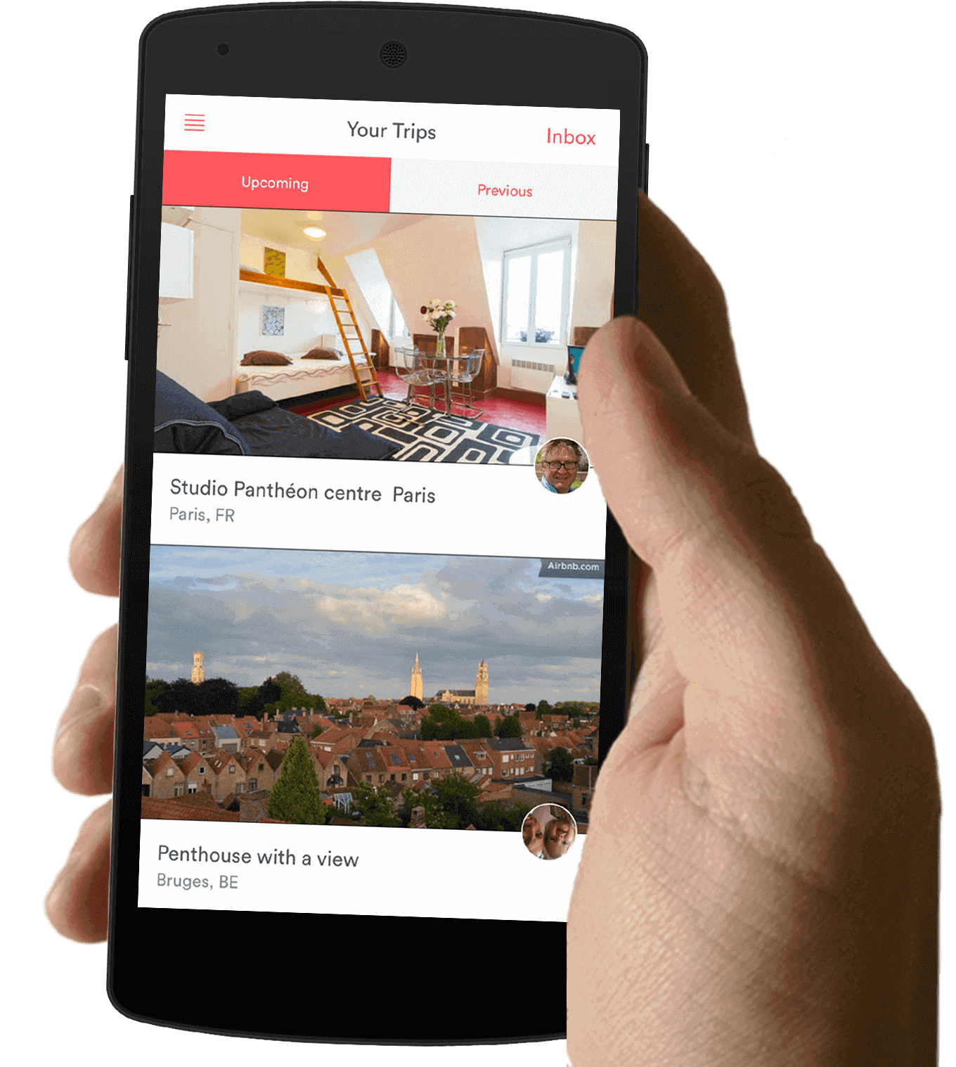
1. Introduction
What is Collaborative Consumption (CC)?
Business based on a digital platform that connects two peers:
Consumer
Service provider
Room
29€/ night
Notes:
In the case of Airbnb, for example, the platform is Airbnb’s application or website, which connects two peers: the travelers looking for accommodation and the hosts offering their homes.

Slide 5
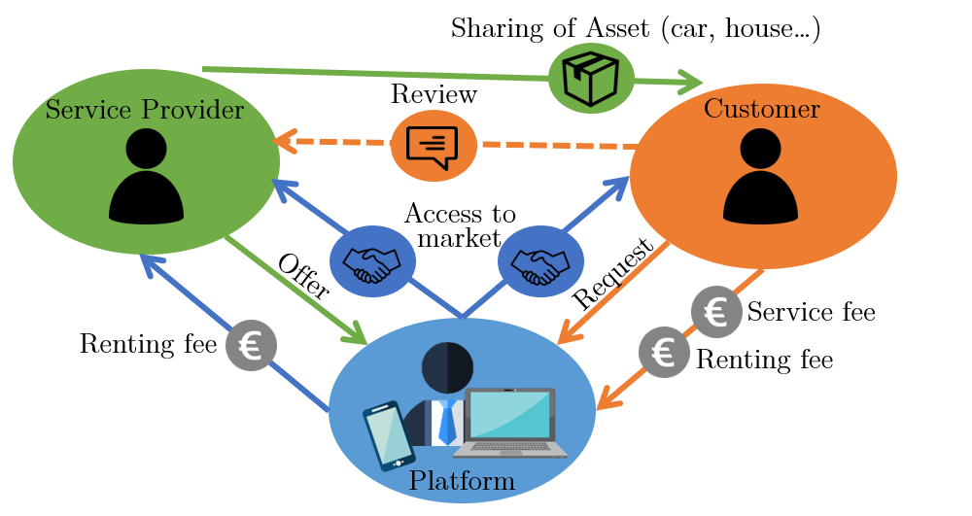
1. Introduction
Roles in Collaborative Consumption:
Consumer
Pays for the service through the platform
Service provider
Shares an asset/ provides a service
Captures a portion of the benefits generated by the platform
Platform
Obtains a profit from enabling the encounter
Shared meal
12€/ person
Notes:
So, what would be the main roles in this type of business model?
We have the consumer, who pays a fee through the platform in exchange for a service
Then there’s the platform, that keeps a part of this fee (in exchange for connecting both peers) and gives the rest to the service provider
Finally there’s the service provider, that obtains some profit from sharing an asset

Slide 6
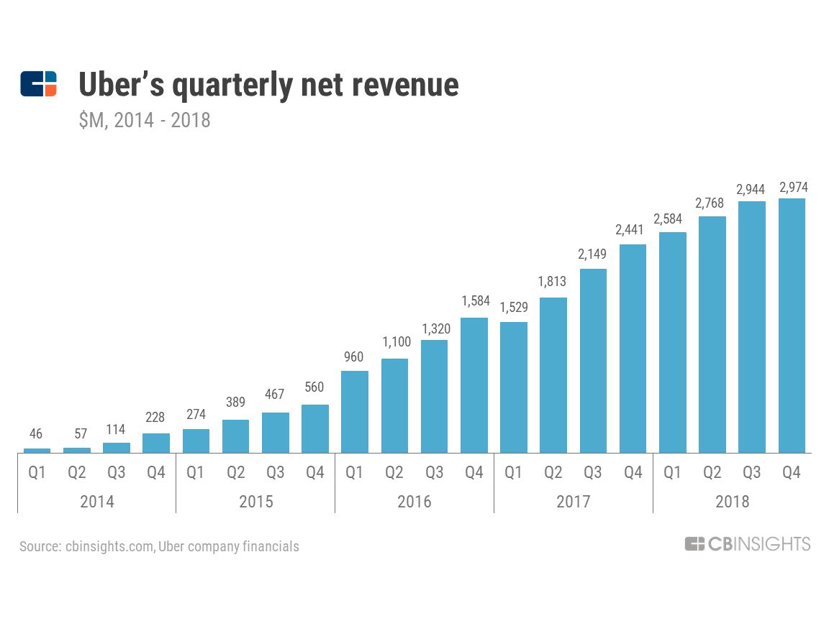
1. Introduction
Shared ride
8€/ person
The rise of Collaborative Consumption: Sector revenues
Uber: $11.300 million in revenue (2018)
Airbnb: $2.600 million (2018)
Notes:
In terms of revenues, we can also see positive trends in this sector, with companies like Uber obtaining more than eleven thousand million dollars in revenue (in 2018) and more than two thousand million dollars in the case of Airbnb
On top of that, according to a study by PwC, it is expected that the sector will grow even more in the future, up to a two thousand percent increase in 10 years

Slide 7
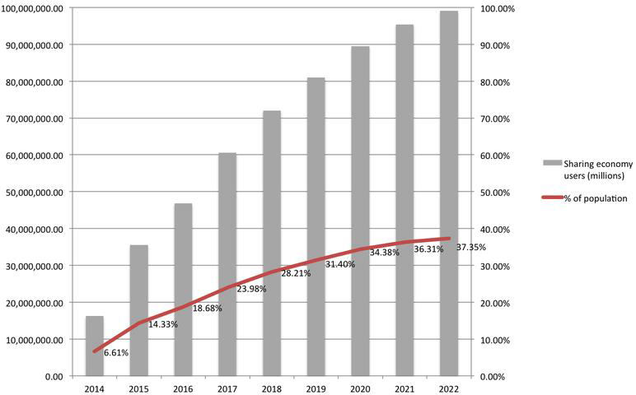
1. Introduction
The rise of Collaborative Consumption: Number of users
Bike
7€/ day
(Böcker & Meelen, 2017)
Notes:
In terms of users, this study published in 2017 predicted that by 2022 up to 36% of the population would be using this type of services in the US
So, as a conclusion, we can see that this sector is being successful in terms of popularity, revenues and number of users.

Slide 8
1. Introduction
Why is it important to manage quality?
Perceived quality in Collaborative Consumption services has been linked to:
Jacket
3€/ day
Customer satisfaction (Möhlmann, 2015)
Customer loyalty (Cheng et al., 2018)
Business profitability (Caruana, 2003)

Slide 9
1. Introduction
Research objective:
Design and validate a scale to assess service quality in Collaborative Transport services (Example: Uber)
Pool
9€/ hour

Slide 10
Content
Introduction
Conceptual framework
Methodology
Results
Conclusions

Slide 11
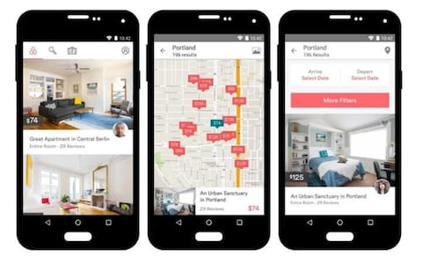
2. Conceptual framework
Previous quality scales for Collaborative Consumption
CC-QUAL (Marimon et al., 2019)
Dimension | Definition
Site organization | Design of the site that makes it appealing and easy to browse.
Platform responsiveness | Quickness to deal with and to establish agreements.
Legal protection | Privacy and legal protection.
Interaction with peer service provider | Professionalism, honesty and empathy of the peer server provider.
Social interaction | Experience interacting with people (other users and the peer provider).

Slide 12
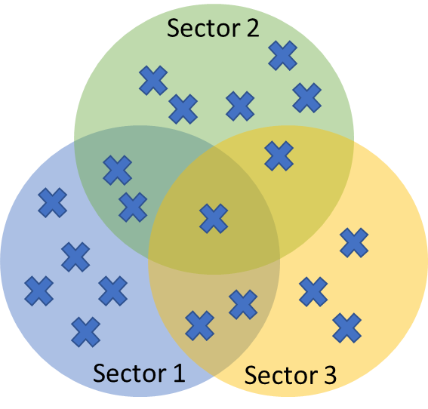
2. Conceptual framework
CC-Qual vs. New scale
CC-Qual
New scale (Transport sector)
Most popular and developed sector in the Collaborative Consumption industry
Transport
Compare results across different countries
Validate the scale in an international setting
400-600
questionnaires

Slide 13
Content
Introduction
Conceptual framework
Methodology
Results
Conclusions

Slide 14
3. Methodology
Literature review
Questionnaire design
Survey
International sample (Europe)
Exploratory analysis
Exploratory factor analysis
Validated scale

Slide 15
Content
Introduction
Conceptual framework
Methodology
Results
Conclusions

Slide 16
4. Results
Validated Scale
Assessment of perceived service quality in the peer-to-peer Transportation sector.
3 dimensions and 11 items
Trust & Social interaction | 1 | This peer-to-peer transportation platform can generally be trusted.
 | 2 | I value that this service offers travelers good social opportunities with the peer transportation provider.
 | 3 | I feel assured that legal structures adequately protect me from problems on the platform.
 | 4 | I believe that the peer transportation providers are generally trustworthy.
Site organization | 5 | This platform's site/ app is easy to use.
 | 6 | The platform's site/ app has easy ordering and payment mechanisms.
 | 7 | The information of the platform's site/ app is well organized.
Comfort | 8 | I value that the vehicle is clean.
 | 9 | I value that the vehicle is comfortable.
 | 10 | I value that the driver is friendly and polite.
 | 11 | I value that the driver keeps an adequate speed and drives safely.

Slide 17
Content
Introduction
Conceptual framework
Methodology
Results
Conclusions

Slide 18
5. Conclusions
Who could use the results of our research?
Can be applied by:
Platform managers
Service providers
Helping them understand and diagnose potential quality problems in their service

Slide 19
Thanks for your attention
Questions?

