Slide 1
CHARISMATIC TEACHER
Dana Dobrovská, David Vaněček
Czech Technical University in Prague
Dpt. pedagogical anf psychological studies

Slide 2
Charisma – definition?
The concept is known, but difficult to be defined.
Charismatic people are supposed to have a special power that makes them able to influence other people and attract their attention and admiration.
They need not to be physically attractive, they may even be handicapped.

Slide 3
WHAT IS CHARISMA?

Slide 4
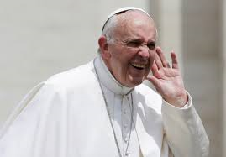
Are they charismatic?

Slide 5
Charismatic teaching
Teaching is often considered a difficult job “that seems easy” (Labaree)
Theory of education, educational psychology and other sciences have explored factors such as teaching methods used by successful teachers, the effects of teachers’ backgrounds or teachers’ personal characteristics and behaviours (for example, enthusiasm, empathy, communication skills, etc.).e, 2000).

Slide 6
Who are successful teachers?
There is no doubt students like to attend some teachers´ classes more than the other´s.
We had conducted surveys about the teaching behaviours good teachers in engineering programmes had in common).
In our research, students reported various qualities - these can be divided into 3 categories:
an expert in his specialization,
he/she should have good didactic, pedagogical and presentation skills
Should have certain human qualities (e.g. humor, disponibility, enthusiasm).

Slide 7
„Good“ +/ „charismatic“ teachers
Students like to attend some teachers´ classes because of special characteristics of their personality.
In some resources these teachers are simply called quality teachers while in other cases the term charismatic teacher was used.
Teaching charisma is described as positive behaviour of a teacher in his class, which can deeply appeal students to learn. While the teacher is perceived approachable, well prepared and sensitive to student needs, students might be committed to work harder. Students are more likely to be receptive to learning under his/her supportive social climate in the classroom.

Slide 8
Can we measure teacher charisma?
Taiwanese authors Huang and Lin (2014) researched the topic of teaching charisma. They identified four merits that deeply attract students and are essential for a charismatic teacher:

Slide 9
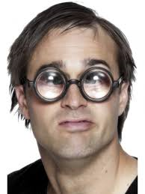
Four Taiwanese Characteristics
First, a charismatic teacher should be knowledgeable, since teaching requires an interweaving of many kinds of specialized and continuously innovated knowledge (also by Dobrovská, 2017, Minchew, 2001, Neumann, 2018).

Slide 10
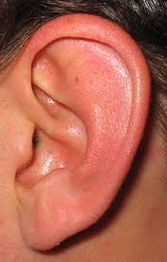
Four Taiwanese Characteristics
A charismatic teacher should have positive character traits such as friendliness, approachability, patience and enthusiasm since teachers are expected to be good role models for the students.

Slide 11
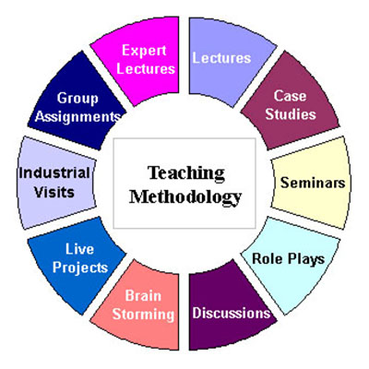
Four Taiwanese Characteristics
Third, a charismatic teacher should attach importance to teaching methods. He/she should possess teaching skills and be able to choose the most suitable teaching method from a variety of teaching tools.

Slide 12
Four Taiwanese Characteristics
Fourth, a charismatic teacher should have a good sense of humor, since students prefer listening to teachers who incorporate humor into the lecture.

Slide 13
How to Measure Teacher Charisma
On the basis of these indicators – knowledge, character traits, teaching methods and humor – an instrument was developed to measure teacher´s teaching charisma (Lin and Huang, 2014). Taiwanese authors summarize the ITCCC (Inventory of Teaching Charisma in the College Classroom) was found a valid and reliable tool to measure the phenomenon in the accounting fundamental course in Taiwan.

Slide 14
Our Study
In order to gain further insight into students´ perspectives of teaching charisma we wanted to explore the possibility of using the ITCCC
in Czech translation
in an engineering pedagogy course

Slide 15
Method and Respondents
Our version is composed of 23 items comprising 4 subscales: character (6 items), knowledge (7 items), humor (7 items), teaching techniques (4 items).
Our research sample: 76 mature-aged students of Czech Technical University in Prague.
Students rated each item on a Likert type scale (1=never true to 5=always true)

Slide 16
Additional Method
Parallel to the questionnaire we added an open ended item – we asked students to complete a sentence …“in my view teacher charisma means…“
We intended to get some more information about the student understanding of the concept (deeper understanding of the connotations).

Slide 17
Results
 | Cronbach α | Mean | SD
Character traits | .854 .828 | 3.37 3.56 | .738 .724
Knowledge | .893 .844 | 3.46 3.88 | .794 .744
Humor | .870 .876 | 2.80 2.88 | .729 .723
Teaching techniques | .839 .822 | 2.64 2.58 | .929 .838

Slide 18
Additional Item
…“in my view, teacher charisma means…“, only 60 respondents of 76 gave the answer.
Charismatic teacher was mostly described by the terms „someone who is better than an average teacher, someone who is able to give good presentations, someone attractive, someone who knows more…“.

Slide 19
Discussion
In our view the subscale „humor“ is overated and the subscale „teaching methods“ is underestimated.
The Czech version of the scale should be tested in another group of students (some other programme)

Slide 20
Teacher Charisma and Student Perfomance?
Lin and Huang mean another future research topic might be potential correlation between teacher charisma and student performance.
Charismatic teachers may be the students´ favorites, but they may not always help students to learn more than the non-charismatic teachers.
Past studies have brought contradictory results. We would like to raise questions about the value of student´ evaluation of teachers and „teacher charisma“ supported by one quantitative method only.

Slide 21
Teacher Charisma and Student Performance?
Students may be learning less than they think they are learning from those they consider the charismatic teachers.
Many university teachers are evaluated on their teaching mostly, or entirely, by asking their students. We believe, though, that students may be evaluating their teachers based upon qualities that contribute little to actual learning.
Teacher charisma represents only ONE of many characteristics the process of learning might be determined by. With a good presenter it might seem like a student is taking more in, but it does not guarantee there has been an „aha“ moment.
Hard work must be done by a learner – a teacher himself cannot do much to foster neuroconnection necessary for learning. Inner motivation represents another important factor as well as divergent thinking model.

Slide 22
Conclusions
Although the Taiwanese scale may be useful for further research of the topic other methods – maybe qualitative ones might become an alternative.
We agree with Milojkovic and Zimbardo charismatic teaching is the one which touches student EMOTIONS, not only reasoning.

