Slide 1
The Effect of Technology on Economic Growth and Global Competitiveness: Keys for Armenian case
Armine Chobanyan

Slide 2
"You can see the computer age everywhere but in the productivity statistics.“ Robert Solow
Introduction
Objective
Main material
Conclusion

Slide 3
Introduction
The technological change is of great importance worldwide, which means the improved product, process, and knowledge. Many countries were able to transform their economies through technology and innovation.
Armenia is a small open economy. Like others, the levels of domestic demand are low, and therefore in order to ensure economic growth, the country should overcome the challenges of international competitiveness.
Developing human resources in science and technology could improve both the countries' global competitiveness and graduate employment prospects.
Implications Science and technology graduates are contributing to the creation, implementation, and dissemination of knowledge and innovation, which in turn can raise the countries' productivity and competitiveness.

Slide 4
Objective
The main objective of the article is to show that technological change, innovation and technology skills are having a positive impact on economic growth and international competitiveness of the country.

Slide 5
Technologies continue to drive significant growth
Indeed every technological change is considered a part of the economic process, and it plays an important role in fueling economic growth.
The total economic impact of Software across
European Union data shows that software
Contributed €1 trillion to total EU value-added
GDP in 2016 — up 9.9 percent from €910 billion in
2014. That compares to an overall EU28 total GDP
growth of 6.0 percent over the same period. The
sector employed (directly impact) 3.6 million
people. Data also indicates that the industry
supported a total of 12.7million jobs across
the 28 EU member states where every €1million
contributed by the sector to GDP meant
€3.28million for the EU economy
Worldwide ICT spending volume has grown approximately 5.6% every year since 2009, and in 2018 the total spending of the ICT sector was 4.81 trillion. The worldwide GDP was 85.8 trillion in 2018. Hence the technology expenses contribute to 5 % of the GDP.

Slide 6
Innovation is a key determinant of whether an entire life quality will grow in a positive way or vice versa. Need to mention that in case a population has a greater ability for production as well as innovation, the higher will be the growth of GDP and global competitiveness of the country.
According to the prediction, the spending of the technology industry will be 5.3 trillion in 2020, and in 2022 the increase will reach 6.06 trillion USD.
Figure 1 Worldwide ICT spending (billion $, 2017-2022)

Slide 7
In the digital economy, the most important technologies are mobility, cloud computing, the Internet of Things (IoT), artificial intelligence (AI), and big data analytics.
Nowadays, productivity sometimes correlated with automation, and here, of course, technological innovation is an essential part of it. Innovation and knowledge are primary driven tools for the next decades.
The high technology sector in Armenia is considered a targeted one by Government. Thus, the development of this sector can be considered as a basis for economic stability and further economic growth.

Slide 8
The role of bringing know-how and new technology will give the country to enter global markets.
The best example of the impact on the growth of the economy is the in-depth research made by McKinsey Co. .
Lessons from outperformers: McKinsey Global Institute Analysis:
For increasing productivity pro-growth policy agenda suggests:
boosting the scale of production and investing in talent,
investing in infrastructure and automation,
increasing total factor productivity by improving technology, innovation,
promoting competition and market efficiency
For income growth pro-growth policy agenda suggests:
boosting household income and middle-class formation through higher wages,
ensuring corporate – profit growth is broadly distributed among companies
For boosting demand, pro-growth policy agenda suggests:
supporting investment by mobilizing domestic savings and capital accumulation,
tapping into regional and global markets by enhancing global connectivity,
driving higher domestic consumption and investment from income and credit growth .

Slide 9
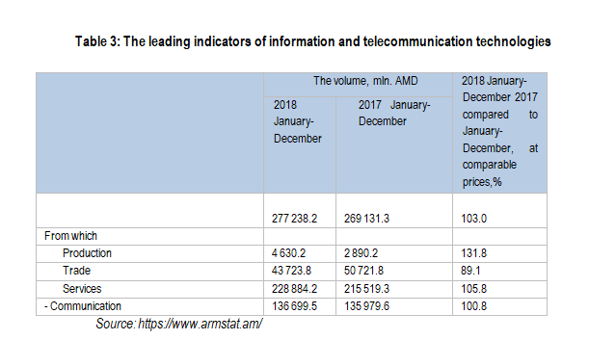
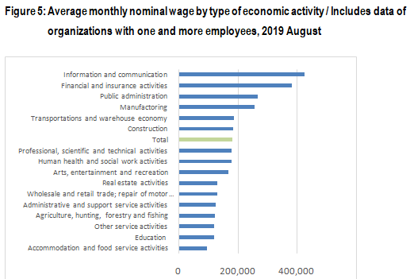
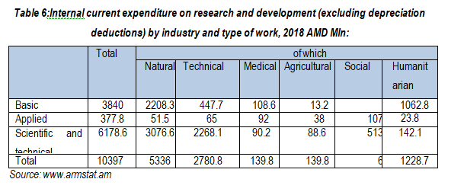
ICT sector in Armenia has its share in GDP and continues to make a positive impact on the economy by the number of companies registered and operating in the sector and creates new jobs.

Slide 10
The best example of the introduction of the new technology to industries and increasing the export in Armenia is the Pharmaceutical sector. As of 2018, the 8 organizations are operating under GMP standards. Since the introduction of the GMP certification, the production and export of the pharmaceutical sector have increased. In particular, the export has increased, on average, 30% every year since 2013, and in 2017, it was 28.8 mln USD. It has doubled compared to 2016.
Pharmaceutical sector export, 2008-2017, thousand USD

Slide 11
Conclusion:
The government of Armenia should accept the wave of change that brings high technology and strengthen the workforce with appropriate knowledge being prepared for the future. Here should be a great focus on practical technology skill development.
Armenia needs to develop his innovation potentials focusing on technology skill development and science.
The government should also develop the proper action plans and strategies fulfilling the process of the introduction of the new technologies, know-how, skills. The creation of a strong connection between science and industry will boost economic growth
Meaningful to mention that as more you have access to data in 21 century as more you benefit. Governments have an important role in helping science to be more open to innovations and create the right mechanism for cooperation toward the best result.

Slide 12
THANK YOU & stay healthy
2020, lockdown

